Slide 1
Getting Started with C#
By Nimesh Kumar Dagur,CDAC, India

Slide 2
Basic C# Syntax
Unlike the compilers of some other languages, C# compilers ignore additional spacing in code, whether it results from spaces, carriage returns, or tab characters (collectively known as whitespace characters).
C# code is made up of a series of statements, each of which is terminated with a semicolon.
C# is a block-structured language, meaning statements are part of a block of code.
These blocks, which are delimited with curly brackets ({ and }), may contain any number of statements, or none at all.
Note that the curly bracket characters do not need accompanying semicolons.

Slide 3
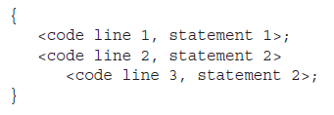
Basic C# Syntax

Slide 4
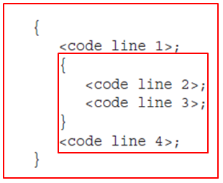
Basic C# Syntax - Indentation
In general, each block of code has its own level of indentation, meaning how far to the right it is.
Blocks of code may be nested inside each other (that is, blocks may contain other blocks), in which case nested blocks will be indented further.
Example:

Slide 5
C# Language Basics - Case Sensitivity
C# is case-sensitive.
Unlike some other languages, you must enter code using exactly the right case, because using an uppercase letter instead of a lowercase one will prevent a project from compiling.
When you define your own variables, it makes sense to follow the conventions used by other C# programmers and the .NET Framework class library.
That means you should give private variables names that start with a lowercase letter and give public variables names that start with an initial capital letter.
Example, you might name a private variable myNumber in C#.

Slide 6
Example
Correct:
Console.WriteLine("The first app in Beginning C# Programming!");
Incorrect:
console.WriteLine("The first app in Beginning C# Programming!");
CONSOLE.WRITELINE("The first app in Beginning C# Programming!");
Console.Writeline("The first app in Beginning C# Programming!");

Slide 7
C# Language Basics - Commenting
Comments are lines of descriptive text that are ignored by the compiler.
C# provides two basic types of comments.
Single-line comment: In this case, the comment starts with two forward slashes and continues for the entire current line
Example:
// A single-line C# comment.
multiple-line comments: C# programmers can use /* and */ comment brackets to indicate multiple-line comments
Example:
/* A multiple-line
C# comment. */

Slide 8
C# Language Basics - Commenting
Multiple-line comments are often used to quickly disable an entire block of code. This trick is called commenting out your code:
/*
... Any code here is ignored ...
*/
This way, the code won’t be executed, but it will still remain in your source code file if you need to refer to it or use it later.

Slide 9
C# Language Basics - Commenting
It was stated earlier that there are two ways of commenting C# code, but there is a third type of comment in C#.
Documentation Comment: C# also includes an XML-based commenting syntax that you can use to describe your code in a standardized way.
With XML comments, you use special tags that indicate the portion of code that the comment applies to.
XML comments always start with three slashes.
The benefit of XML-based comments is that automated tools (including Visual Studio) can extract the comments from your code and use them to build help references and other types of documentation.

Slide 10
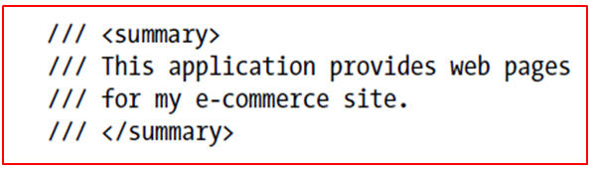
C# Language Basics - Commenting
Example:

Slide 11
General Structure of a C# Program
C# programs can consist of one or more files.
Each file can contain zero or more namespaces.
A namespace can contain types such as classes, structs, interfaces, enumerations, and delegates, in addition to other namespaces.

Slide 12
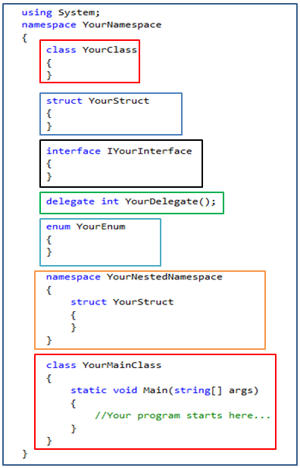
General Structure of a C# Program

Slide 13
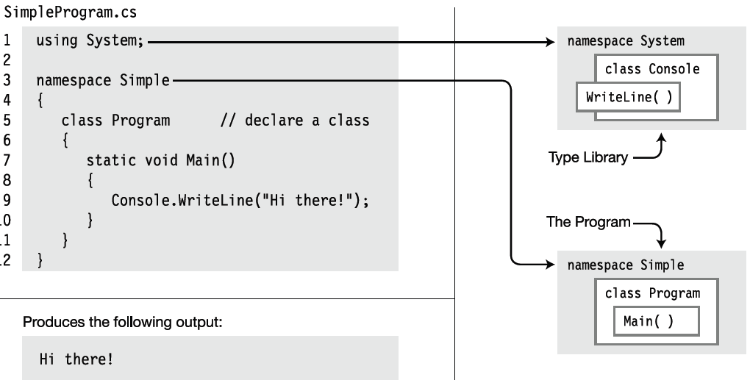
A Simple C# Program

Slide 14
A Simple C# Program - Explanation
Line 1: Tells the compiler that this program uses types from the System namespace.
Line 3: Declares a new namespace, called Simple. The new namespace starts at the open curly brace on line 4 and extends through the matching curly brace on line 12. Any types declared within this section are members of the namespace.
Line 5: Declares a new class type, called Program. Any members declared between the matching curly braces on lines 6 and 11 are members that make up this class.

Slide 15
A Simple C# Program - Explanation
Line 7: Declares a method called Main as a member of class Program. In this program, Main is the only member of the Program class. Main is a special function used by the compiler as the starting point of the program.
Line 9: Contains only a single, simple statement; this line constitutes the body of Main. Simple statements are terminated by a semicolon. This statement uses a class called Console, in namespace System, to print out the message to a window on the screen .Without the using statement in line 1, the compiler wouldn’t have known where to look for class Console.

Slide 16
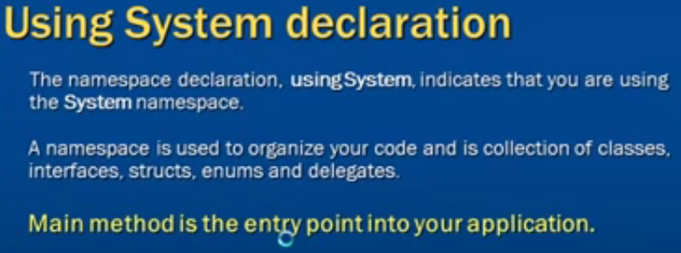

Slide 17

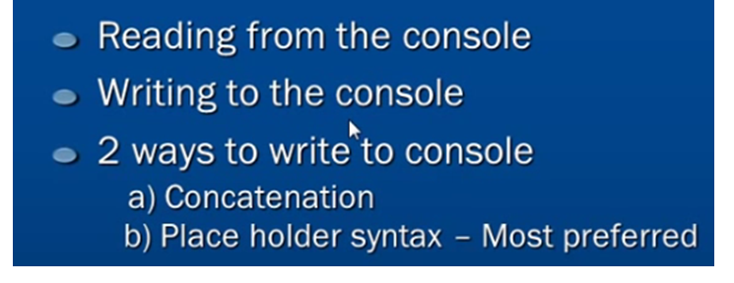

Slide 18
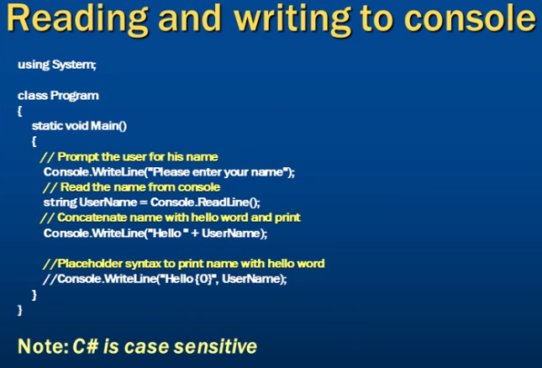

Slide 19

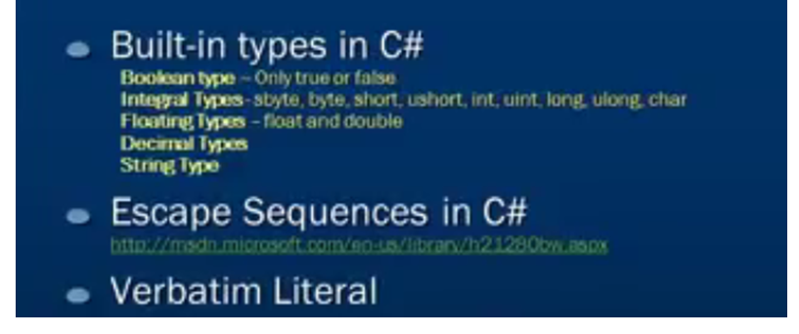

Slide 20
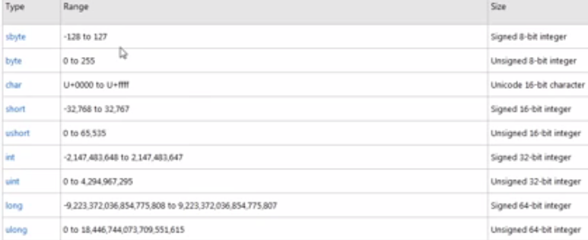

Slide 21

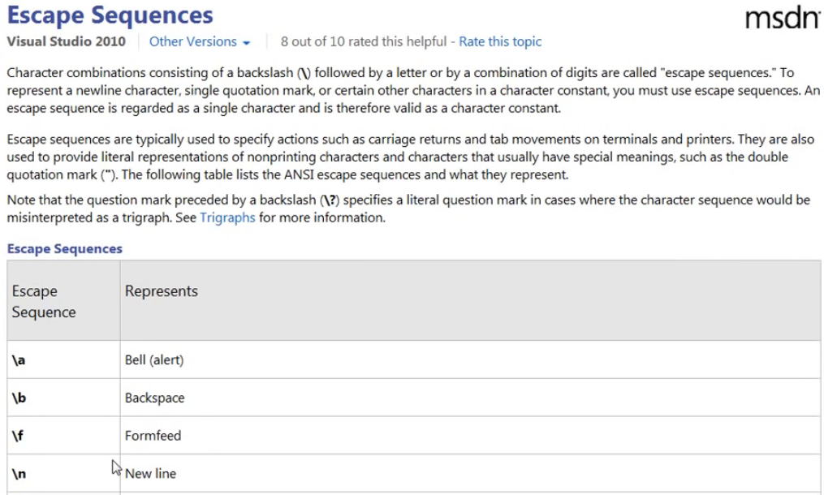

Slide 22
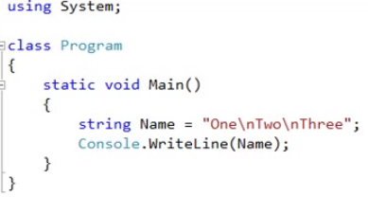
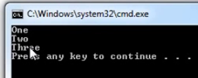

Slide 23
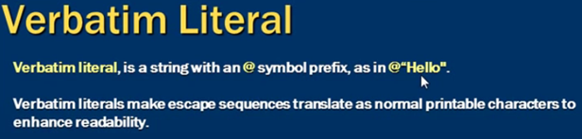

Slide 24
Identifiers
Identifiers are character strings used to name things such as variables, methods, parameters etc.
You can create self-documenting identifiers by concatenating meaningful words into a single descriptive name, using uppercase and lowercase letters (e.g., CardDeck, PlayersHand, FirstName, SocialSecurityNum).
Certain characters are allowed or disallowed at certain positions in an identifier.

Slide 25
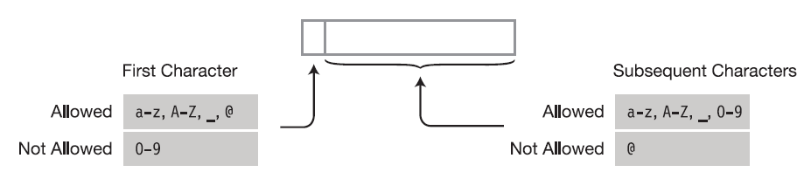
Identifiers
Guidelines to use Identifiers:
The alphabetic and underscore characters (a through z, A through Z, and _) are allowed at any position.
Digits are not allowed in the first position but are allowed everywhere else.
The @ character is allowed in the first position of an identifier but not at any other position.
Identifiers are case-sensitive. For instance, the variable names myVar and MyVar are different identifiers.

Slide 26
The C# Keywords
Keywords are the character string tokens used to define the C# language.
Keywords cannot be used as variable names or any other form of identifier, unless prefaced with the @ character.
All C# keywords consist entirely of lowercase letters. (.NET type names, however, use Pascal casing.)

Slide 27
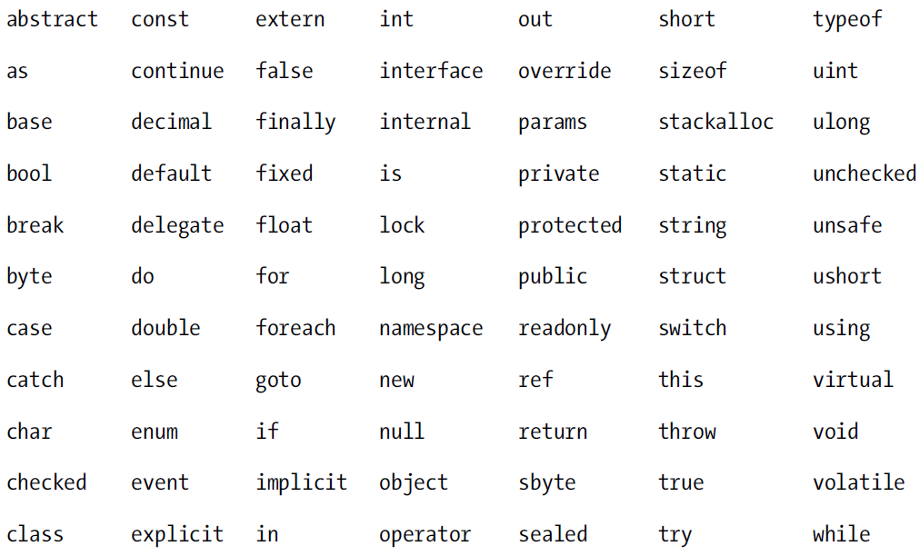
The C# Keywords

Slide 28
Text Output from a Program
A console window is a simple command prompt window that allows a program to display text and receive input from the keyboard.
The BCL supplies a class called Console (in the System namespace), which contains methods for inputting and outputting data to a console window.

Slide 29
Write
Write is a member of the Console class.
It sends a text string to the program’s console window.
In its simplest form, Write sends a literal string of text to the window.
The string must be enclosed in quotation marks—double quotes, not single quotes.
Write does not append a newline character after a string

Slide 30
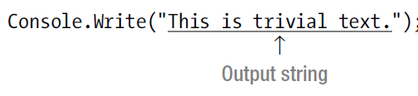


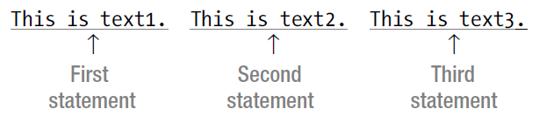
Write -Example

Slide 31

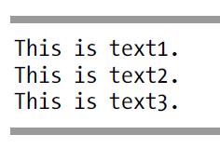
WriteLine
WriteLine is another member of Console; it performs the same functions as Write but appends a newline character to the end of each output string.

Slide 32
The Format String
The general form of the Write and WriteLine statements can take more than a single parameter.
If there is more than a single parameter, the parameters are separated by commas.
The first parameter must always be a string and is called the format string.
The format string can contain substitution markers.

Slide 33
A substitution marker marks the position in the format string where a value should be substituted in the output string.
A substitution marker consists of an integer enclosed in a set of matching curly braces.
The integer is the numeric position of the substitution value to be used.
The parameters following the format string are called substitution values.
These substitution values are numbered, starting at 0.

Slide 34
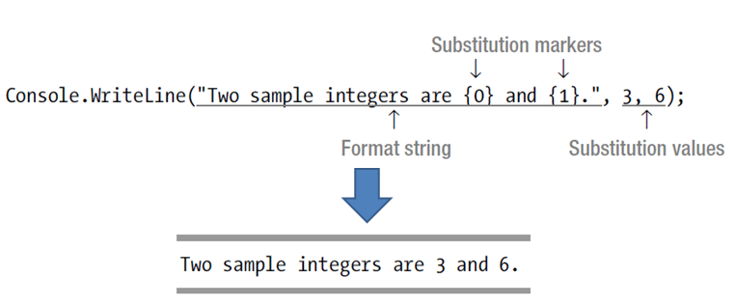
Syntax:
Console.WriteLine( FormatString, SubVal0, SubVal1, SubVal2, ... );
Example:

Slide 35
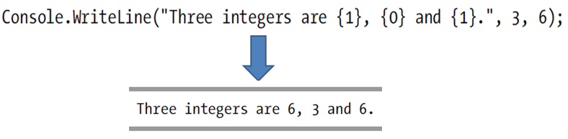
Multiple Markers and Values
In C#, you can use any number of markers and any number of values.
The values can be used in any order.
The values can be substituted any number of times in the format string.
Example:

Slide 36
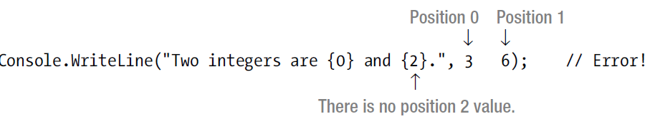
Multiple Markers and Values
A marker must not attempt to reference a value at a position beyond the length of the list of substitution values.
If it does, it will not produce a compile error but a runtime error (called an exception).
,

